Slide 1

Learning a locomotion controller for a quadrupedal robot with Deep Reinforcement Learning
MaRBle 2018-2019
Mathieu Coenegracht, Charlotte Dalenbrook, Kaspar Kallast, Samuel Kopp
Department of Data Science and Knowledge Engineering, 08.07.2019
MaRBle

Slide 2
Outline
Project Story
Learning a Locomotion Gait
Learning on Rough Terrain
Robot Morphology for Rough Terrain
Project Conclusion & Credits
References
Notes:
Samuel

Slide 3
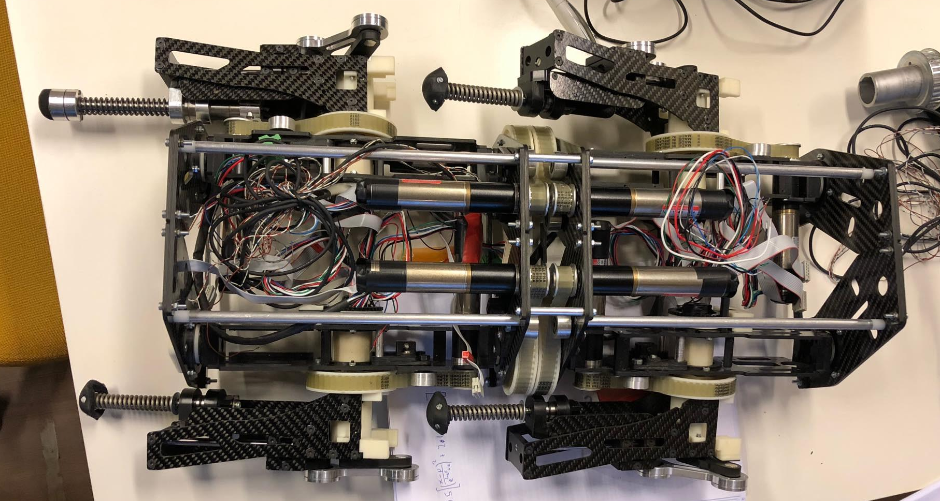
1. Project story: Goals and challenges
Original Goals:
Rough terrain controller by guiding learning progress
Find optimal morphology for the SwarmLab-Robot
3 sections with different focus:
Learning
Terrain Generation
Morphology
Pivot
Hurdles:
Time & Experience
License for Simulation Tool
Testing Speed
Motor Controllers

Slide 4
Learning a Locomotion Gait
Why use reinforcement learning?
Research question
Methodology
Experiments
Results & Discussion

Slide 5
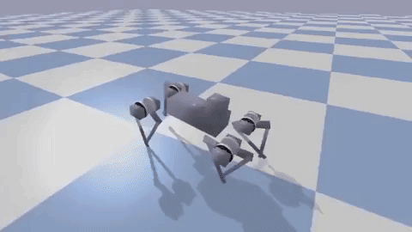
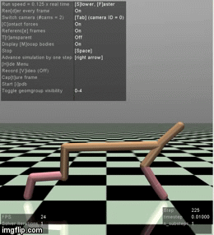
Why Use Reinforcement Learning?

Slide 6
Research Question
How do different choices for the observation and action space affect the learning process?
Notes:
Samuel

Slide 7
RL-Background
Markov Decision process (S, A, P, R)
S: State Space
A: Action Space
P(s’|s,a): S x A → Pr(S)
R(s, a, s’): S x A x S → ℝ
Policy 𝜋(s, a)
Expected return J(𝜋)
Goal: find a policy 𝜋 that maximizes J(𝜋)
Notes:
Samuel

Slide 8
Proximal Policy Optimization(PPO)
On-policy
Trust-region
Tends to be monotonically improving
Multiple Actors in Parallel
Schulman, John, et al. "Proximal policy optimization algorithms." arXiv preprint arXiv:1707.06347 (2017).
Notes:
Samuel

Slide 9
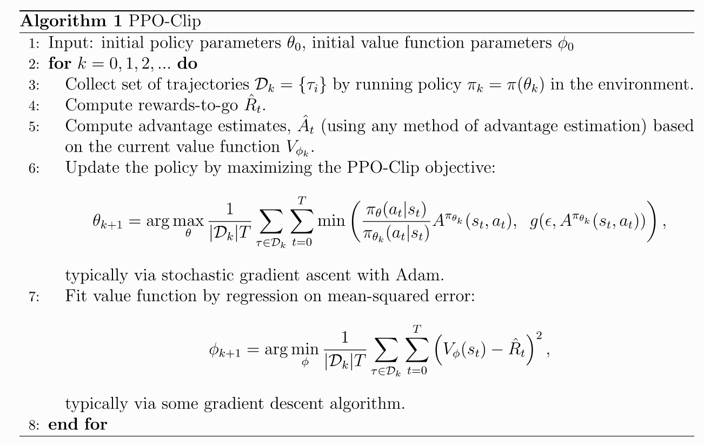
Proximal Policy Optimization(PPO)

Slide 10
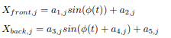
Actions & Motor Control
A: Direct Joint Angles
PID-controller
significantly better learning, gait quality and robustness than torques or velocity[1]
B: Feedback Oscillation
with 2 DoF
, f is frequency
→ Galloping Motion
Feedback Oscillation
with 6 DoF
→ Combination of A for Shoulders & B for Contraction
[1] Bin et al, Learning locomotion skills using deeprl: Does the choice of action space matter? (2017)

Slide 11
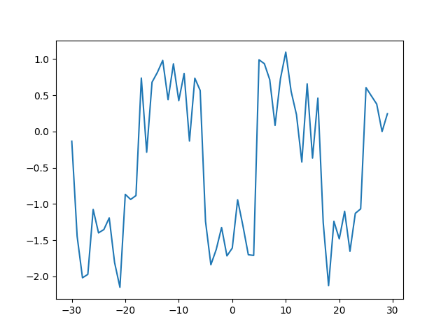
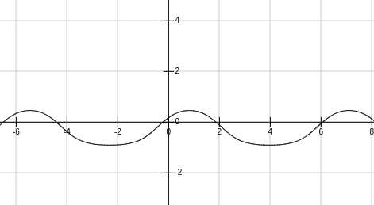
Oscillation with constants
Feedback Oscillation
Notes:
Charlotte

Slide 12
Observation Space
Environment partially observable
Increase in dimensionality → increase in time[2]
Comparison of 5 observations spaces:
Joint positions
Joint positions and velocities
External forces
Inertia and velocities of com
External forces + Inertia and velocities
Notes:
In the real world not possible for agent to have complete knowledge of the environment
Choices have to be made with regards to sensors when designing robots
Larger observation space leads to longer training time, therefore sticking many sensors on robot does not necessarily increase an agents ability to efficiently learn a good policy
A trade-off has to made between high return and keeping training time managable
We were interested in how the choice of observation space affects an agents ability to learn a good policy within reasonable time
Joint positions → network has to infer velocities

Slide 13
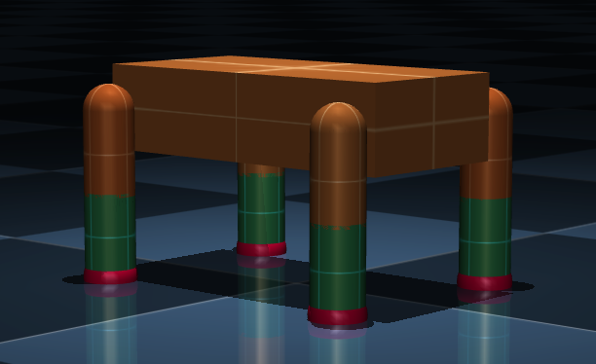
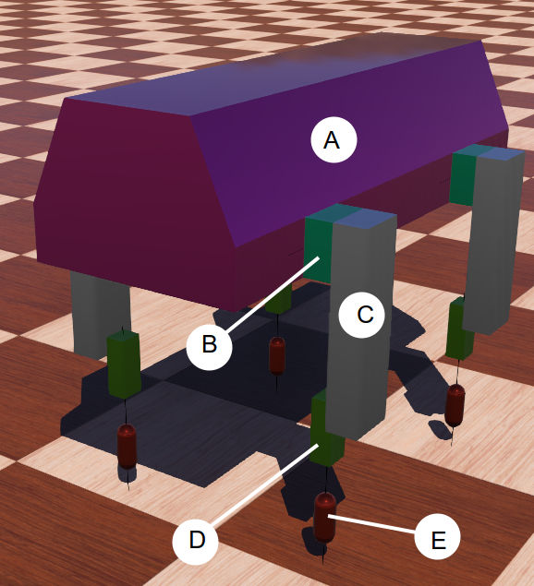
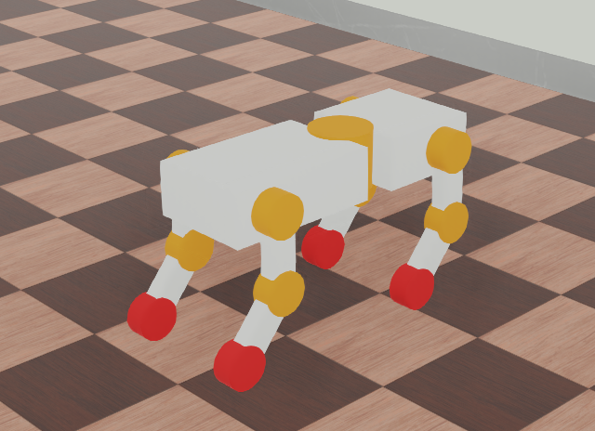
Simulation & Robot Models
MuJoCo SLIP Quadruped
Webots Swarmlab Quadruped
Webots EPFL Ghostdog

Slide 14
Experiments
Action space
Ghostdog, Swarmlab Quadruped
3 seeds, 50/100 epochs, 1000/2000 steps per epoch
Observation space:
MuJoCo SLIP Quadruped
10 seeds, 500 epochs, 4000 environment steps
Reward: r = d + s - e

Slide 15
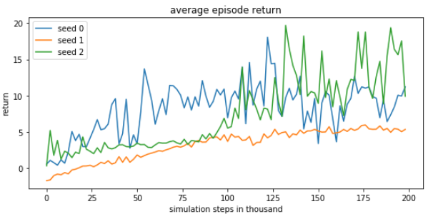
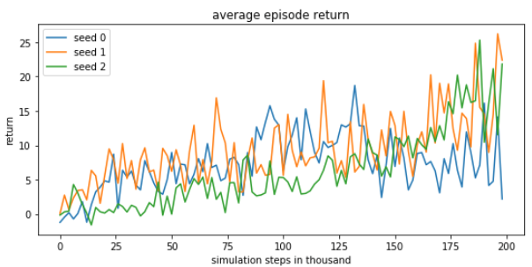
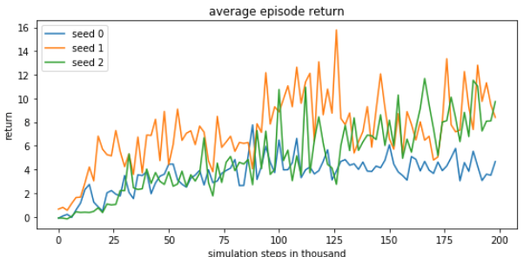
Results: Action Space
Swarmlab quadruped
Agent unable to learn a gait
Model might be unable to balance
Possible that actions rarely lead to balanced step
EPFL Ghostdog
Feedback-oscillation with 2 DoF produced consistently stable gait
Feedback-oscillation and position control 6 DoF unable to learn stable gait
PPO seems to have trouble learning stable gaits when dimensionality is higher
Notes:
Swarmlab Quadruped
All 3 control methods unable to learn gait
Agent only able to achieve small reward by falling to the right
Slider joints used to model spring behave chaoticallyI (Incorrect spring parameters)
Actions too random rarely lead to balanced step and single policy gradient not sufficient to leverage this behaviour
Off-policy algorithm with experience buffer might suffer less from this
Ghostdog
Other two control methods similar reward but unstable gait
Problem finding stable gaits could be attributed to lack of hyperparameter tuning, and short learning times
Set of tuned constant parameters for 2DoF feedback-oscillation performs better
Figures: top pos control 6dof
Middle feedback-oscillation 2dof
Bottom feedback-oscillation 6dof

Slide 16
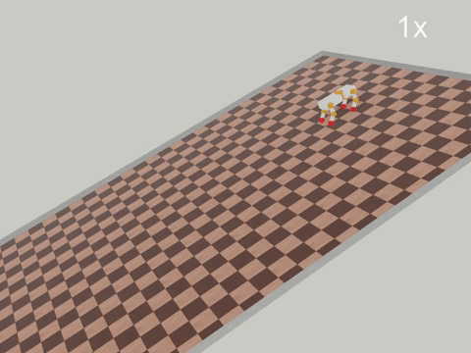
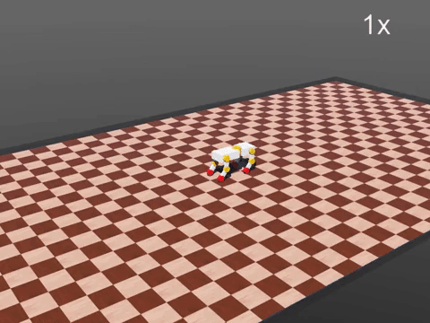
Trained policies on Ghostdog
12 DoF direct position control
2 DoF feedback oscillation

Slide 17
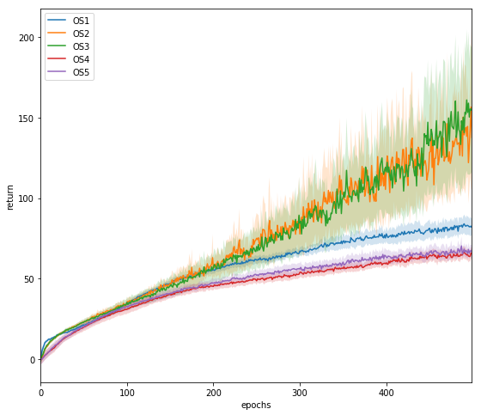
Results: Observation space
Agent unable to successfully infer velocities using positions.
Similar performance between using joint velocities and external forces
Despite OS3’s larger size
Performance drop when including COM inertia and velocities
Similar performance when additionally including external forces
Notes:
Large difference between blue and orange indicates unable to infer velocities
Similar performance green and orange, despite large difference in observation size
This possibly indicates a performance difference when training longer, however not able to test this hypothesis
Poor performance of red and purple. Possibly caused by
Large increase in size of state vector
Similar / slightly better performance despite OS5’s larger size
Possible that this is due to wider variety of information

Slide 18
Learning on Rough Terrain
Apply reinforcement learning to learn locomotion on various kinds of courses
Webots
Terrain Generator

Slide 19
Making the Terrain Generator
Controller/Supervisor scripts
VRML97 world description
Webots excellent UI

Slide 20
Terrain Generator Overview
Main platform
Elevation grid
Obstacles
Contact Properties
Randomization of terrain properties

Slide 21
Elevation Grid
Robot dropped on elevation grid
Can instantly fall after drop due to uneven terrain
To counter this: stabilizing force and reset physics upon contact with elevation grid
Elev. grid is fit to main platform’s size

Slide 22
Encountered Bugs
Bounding object of solid not updating correctly
Change in centre of mass when spawning new robot model

Slide 23
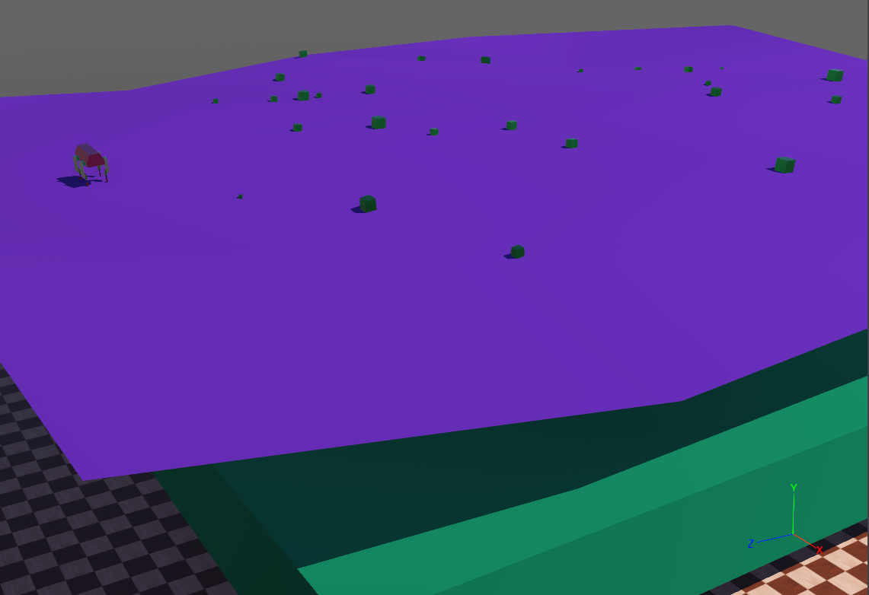
Example Terrain

Slide 24
Experiments
GhostDog model was used
Easy elevation grid
Hard elevation grid
3 * 100 epochs each terrain (2000 steps/epoch)
Terrain generator and learning procedure not directly connected (but ideally should’ve been)

Slide 25
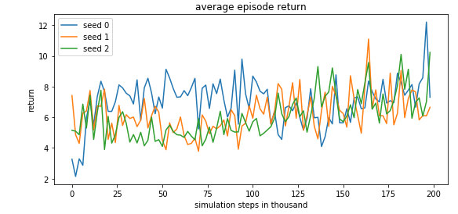
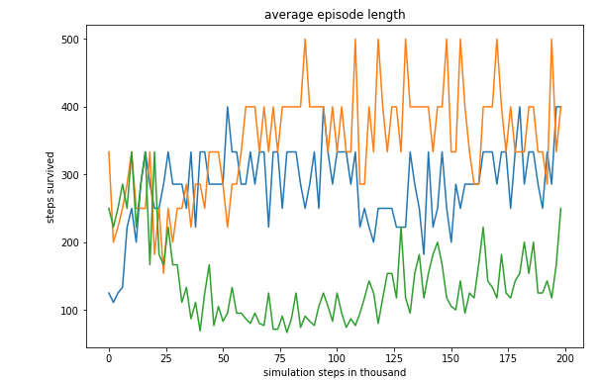
Easy Terrain Results
All three trials learnt a slow gait
Dragging rear legs with two front legs

Slide 26
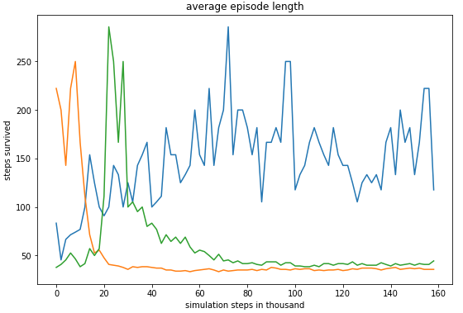
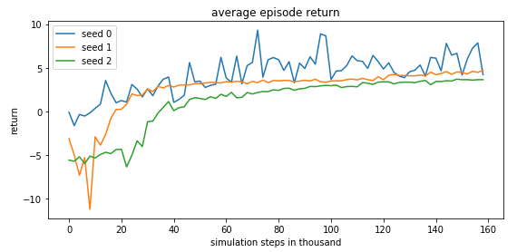
Hard Terrain Results
2/3 trials failed to learn a form of locomotion
Stopped after 80 epochs on 2 failed trials

Slide 27
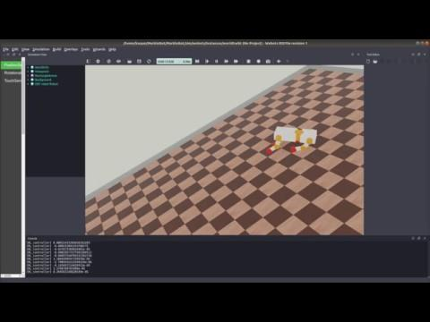
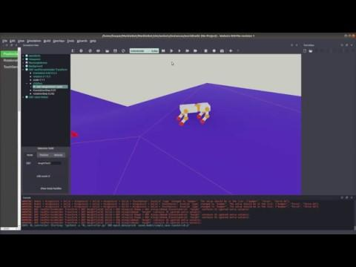
Trial samples
Gait learnt on easy elev Hard elevation grid trial

Slide 28
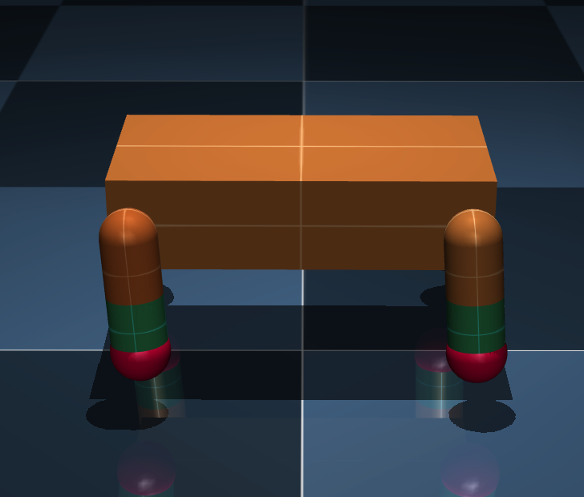
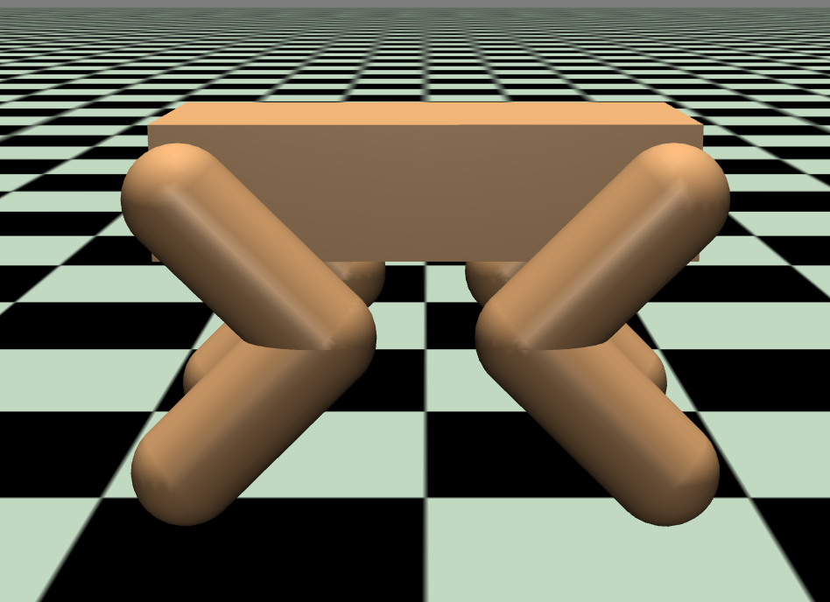
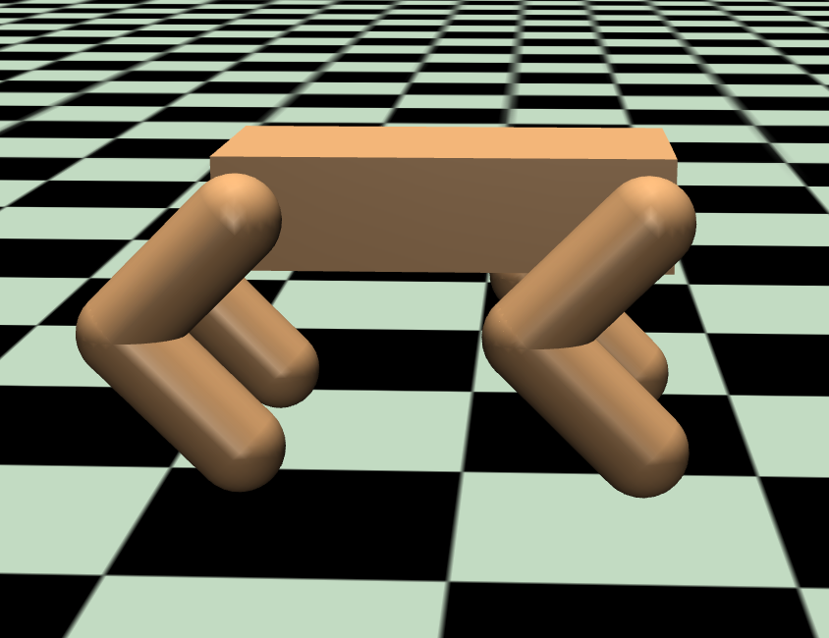
Robot Morphology
3 morphologies (shown below)
Rough and Flat Terrain
Compare performance
Goal: suggestion of morphology according to terrain

Slide 29
Research Question
To what extent do hardware alterations such as the full length of the legs, the leg type, and the number of degrees of freedom available change the performance of a quadrupedal robot over both rough and flat terrain?

Slide 30
Experiments
How does…
Leg length of a SLIP model robot
Number of degrees of freedom on a SLIP model robot
Leg design on a quadrupedal
Affect performance
Each experiment:
500 epochs
5 trials

Slide 31
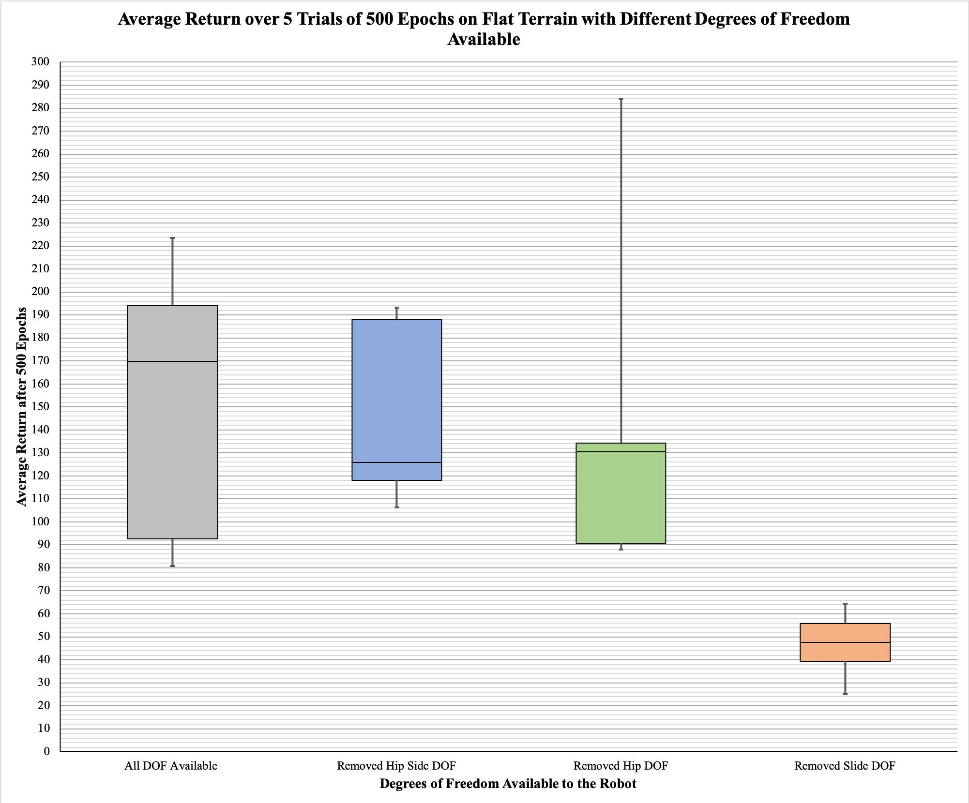

Slide 32


Slide 33
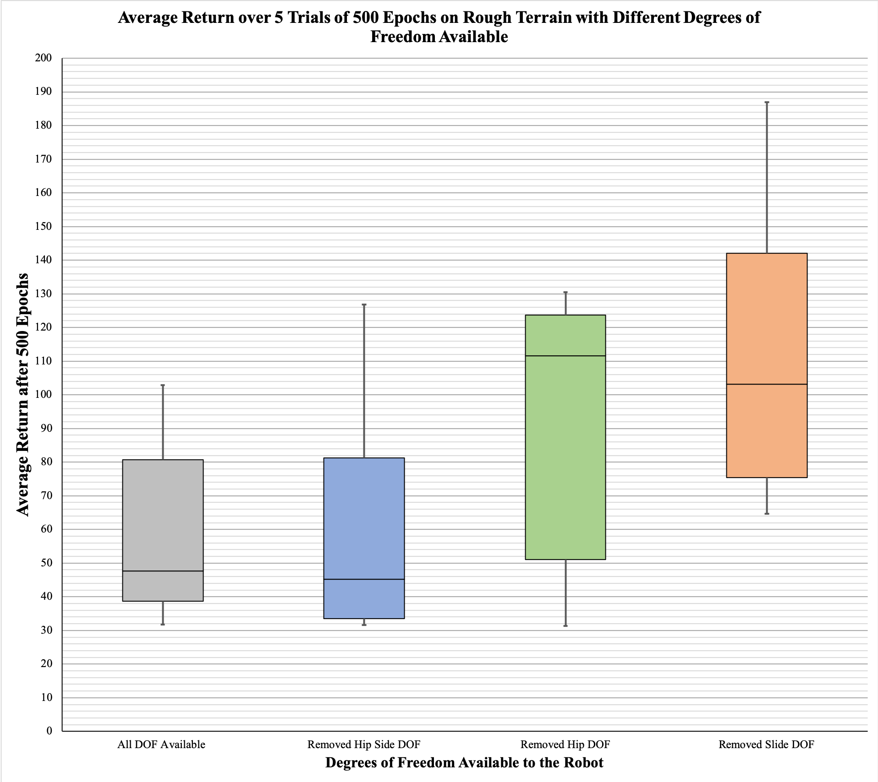

Slide 34
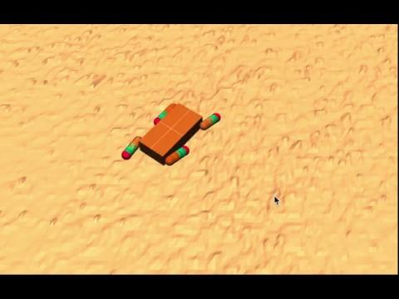

Slide 35
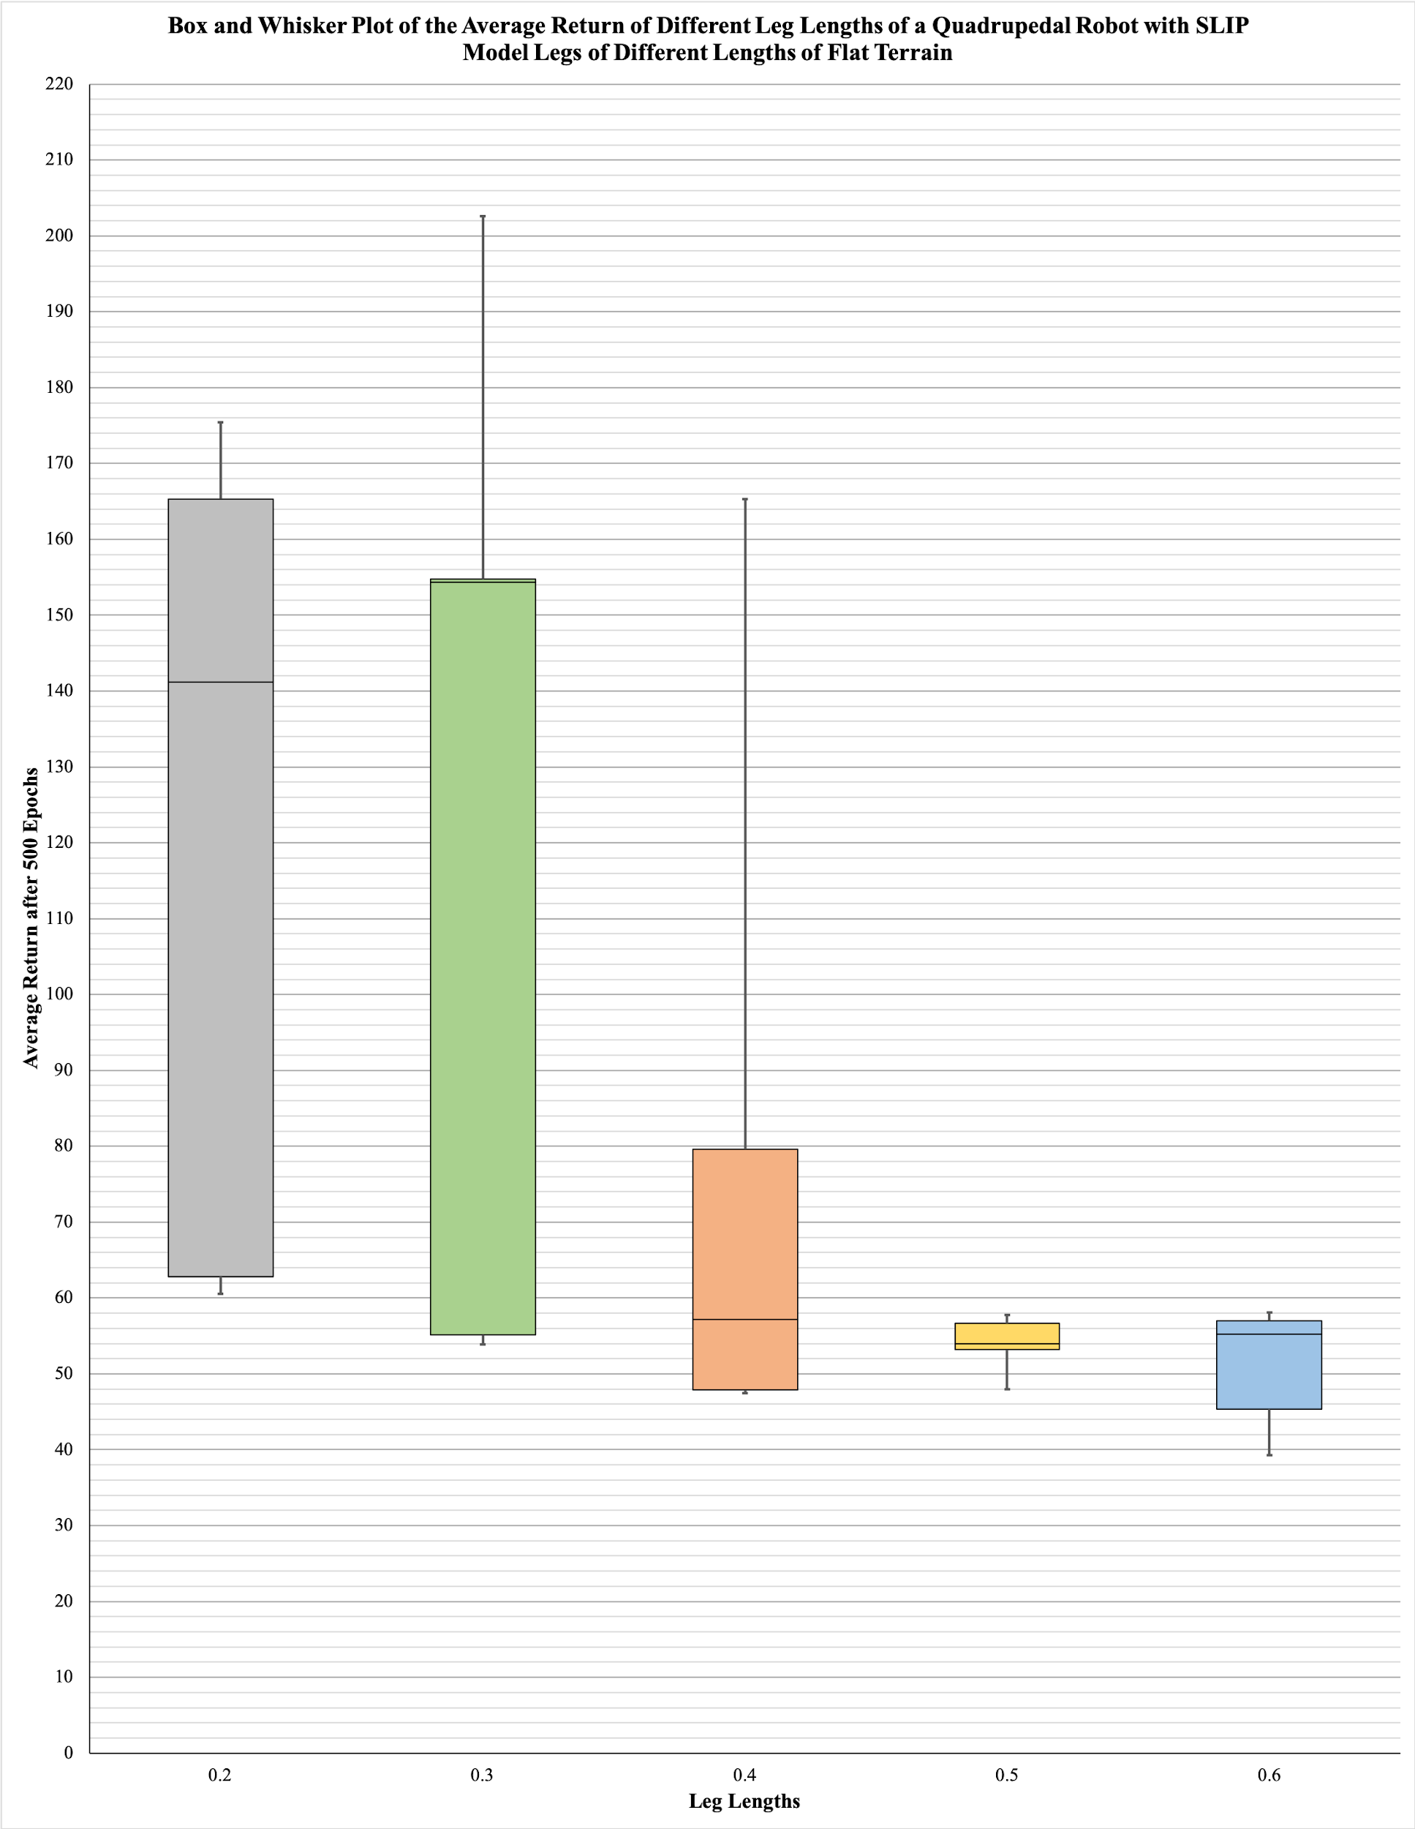

Slide 36
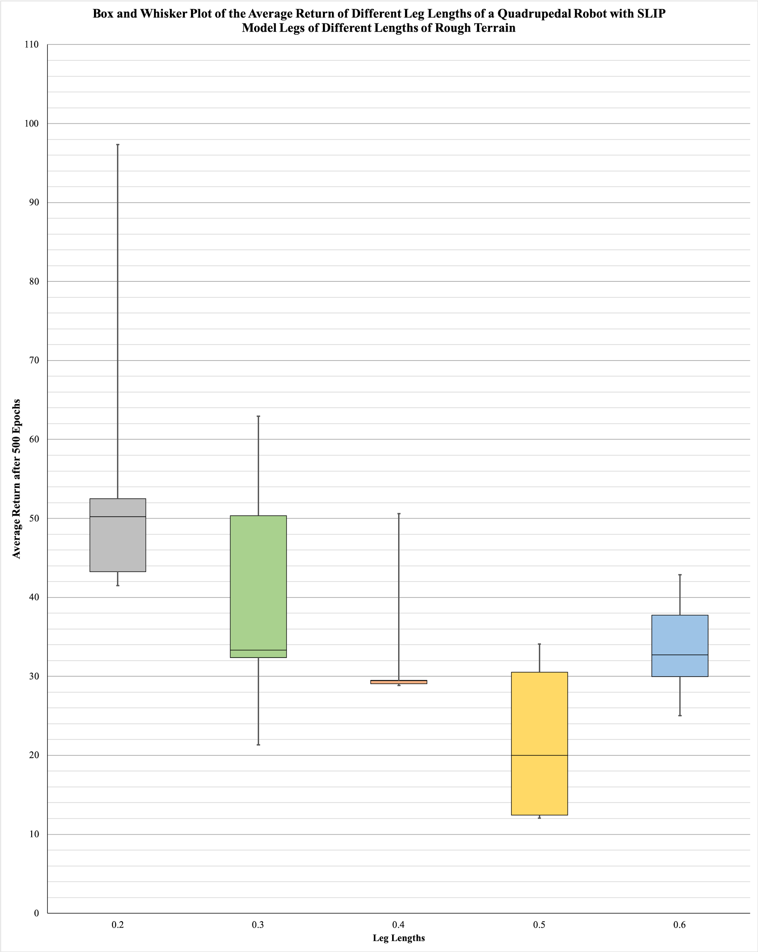

Slide 37
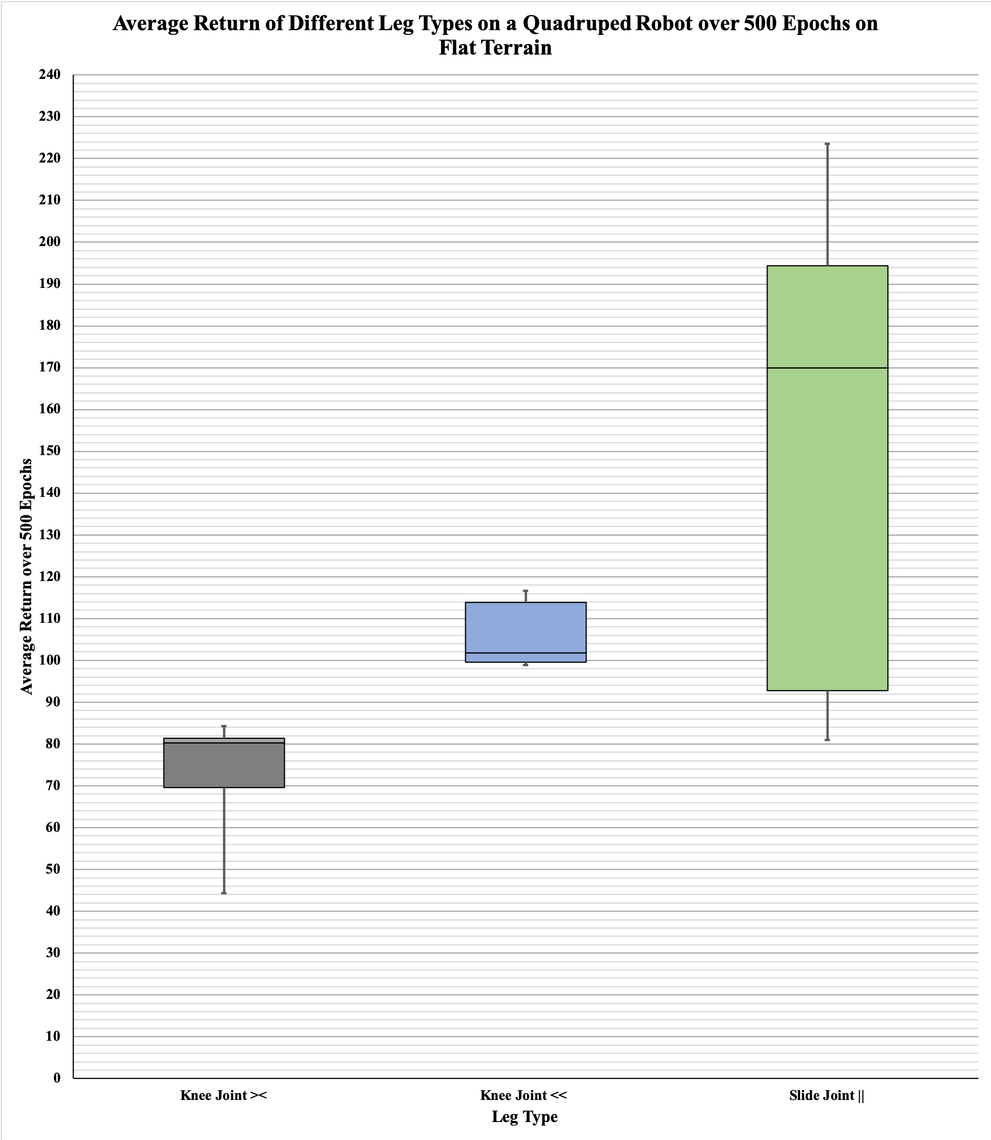

Slide 38
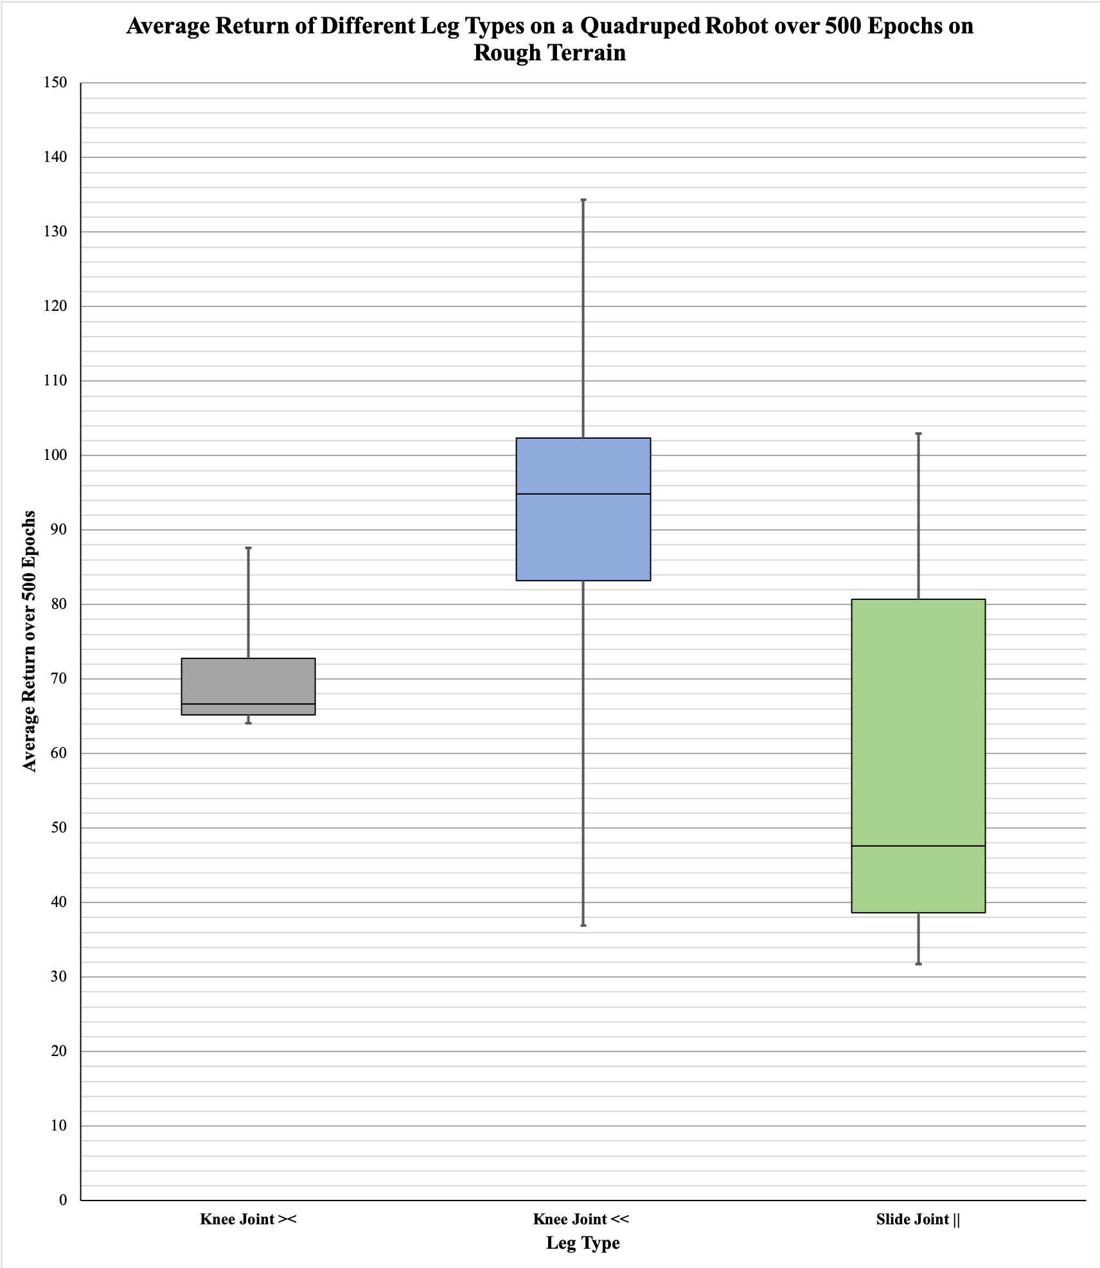

Slide 39
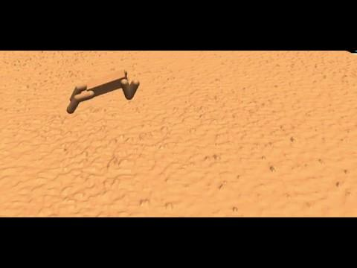

Slide 40
Morphology Conclusions
Rough Terrain:
Leg design: knee joints facing in same direction
Leg length: 0.2; ratio leg length to torso length: 1:2
Degrees of freedom: hip degree removed
Flat Terrain:
Leg design: SLIP model straight legs
Leg length: 0.25; ratio leg length to torso length 5:8
Degrees of freedom: all

Slide 41
Conclusion
Our project:
A good algorithm isn’t enough
One algorithm performs very differently in distinct situations
Many changes need to be made

Slide 42
References
[[1]Peng, Xue Bin, and Michiel van de Panne. "Learning locomotion skills using deeprl: Does the choice of action space matter?." Proceedings of the ACM SIGGRAPH/Eurographics Symposium on Computer Animation. ACM, 2017.
[2] WHITEHEAD, Steven D. A Complexity Analysis of Cooperative Mechanisms in Reinforcement Learning. In: AAAI. 1991. p. 607-613.
APA

